Slide 1


ANGULAR and RxJS
CACIB TECHTALK
Notes:
Proceed to next slide

Slide 2

we tend to think
SYNCHRONOUSLY
Notes:
Left to right
Top to bottom
Block of code

Slide 3

but work ASYNCHRONOUSLY
Handling user inputs
Animations
Websockets
API calls
Notes:
But when it comes to front-end devt

Slide 4
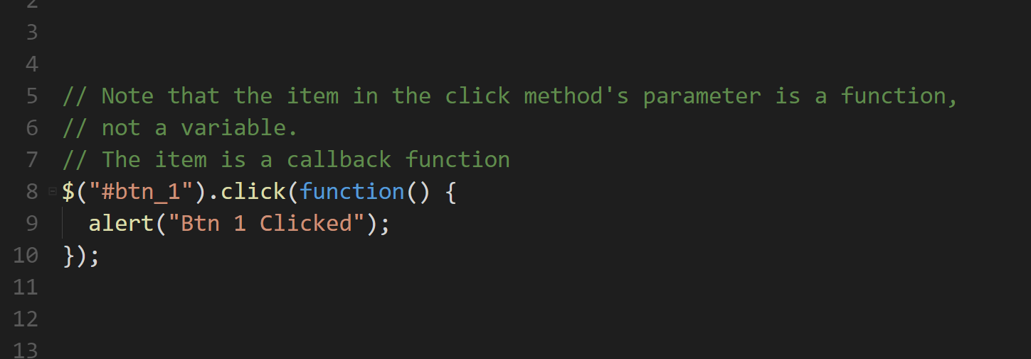

Slide 5


Slide 6
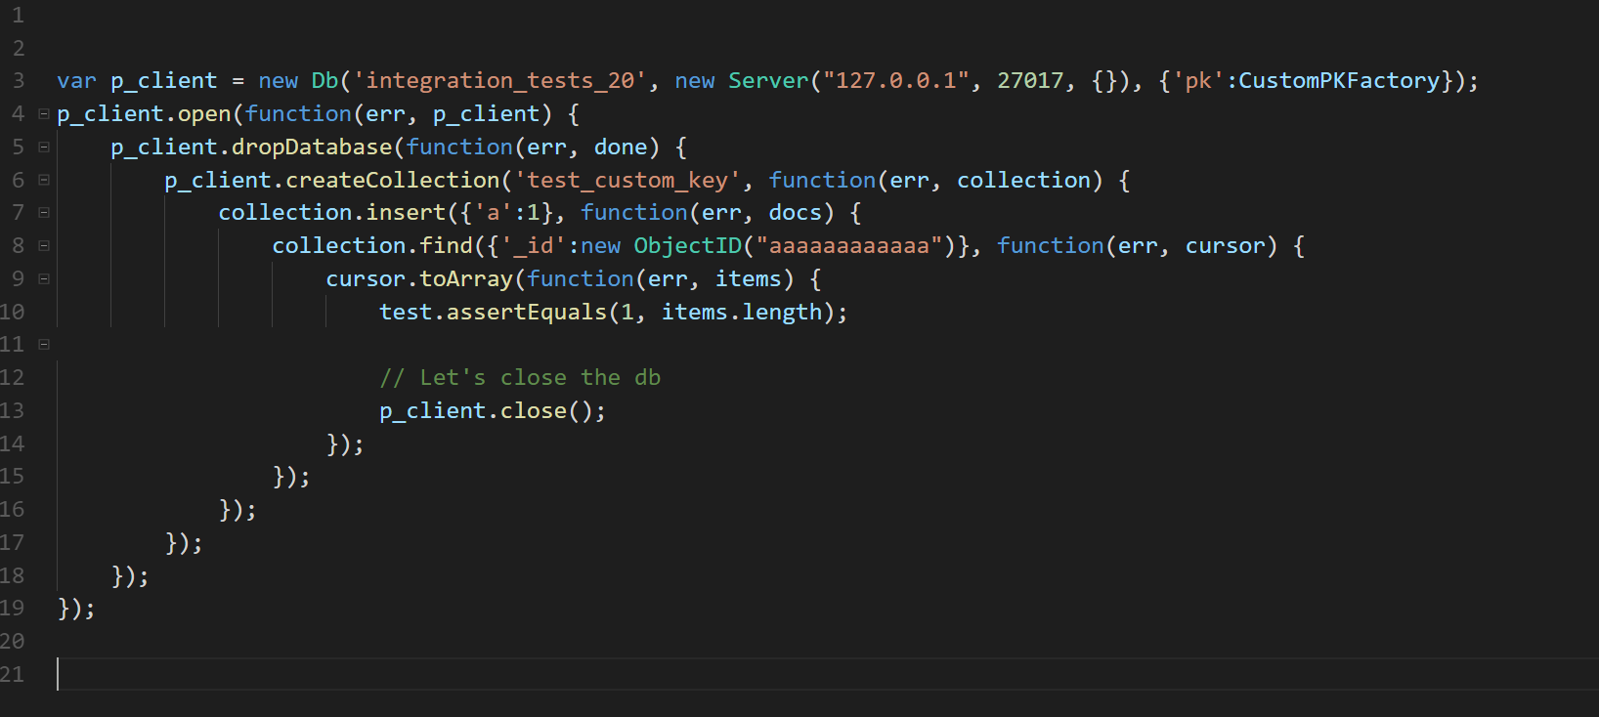

Slide 7
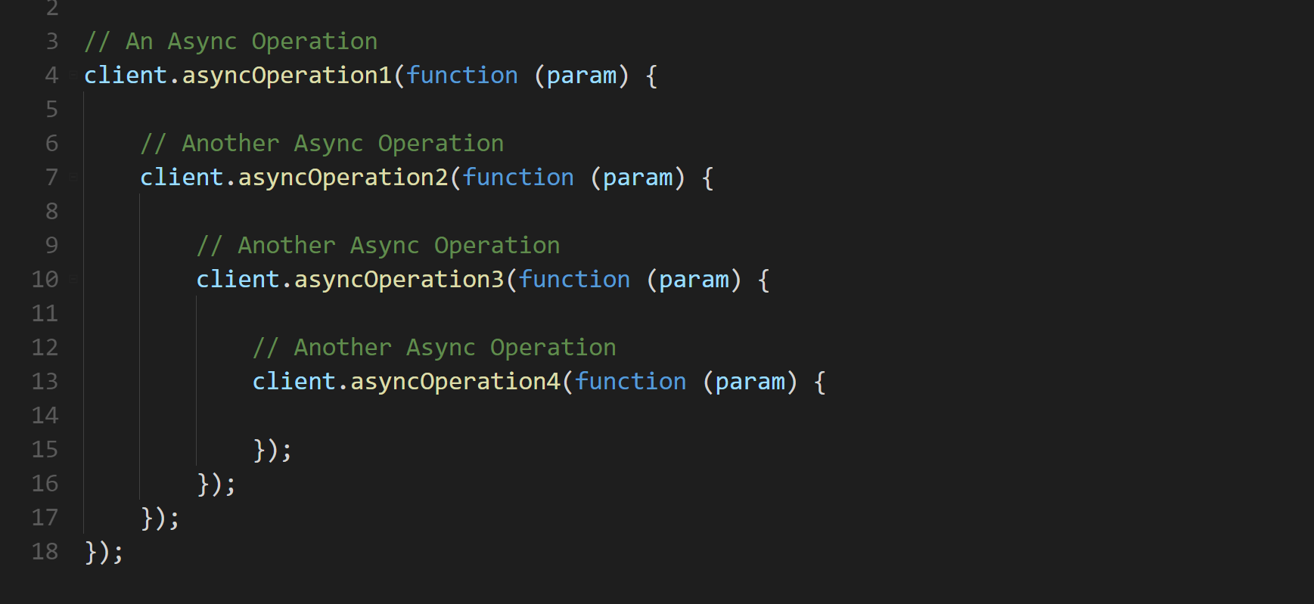

Slide 8
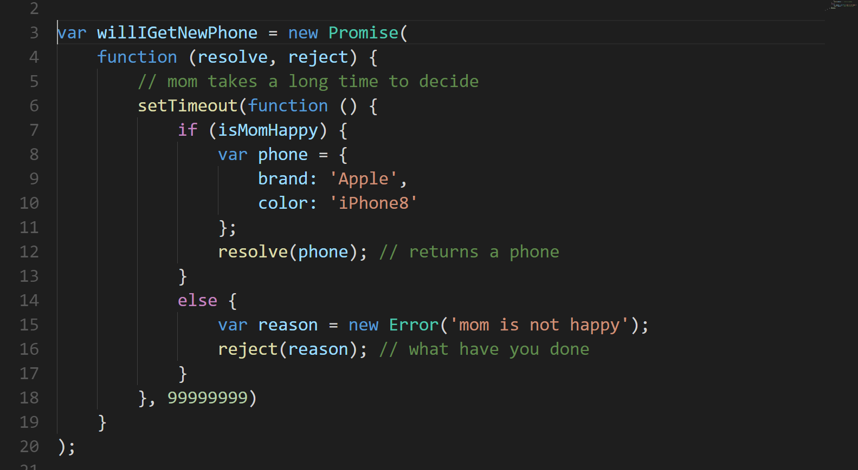

Slide 9
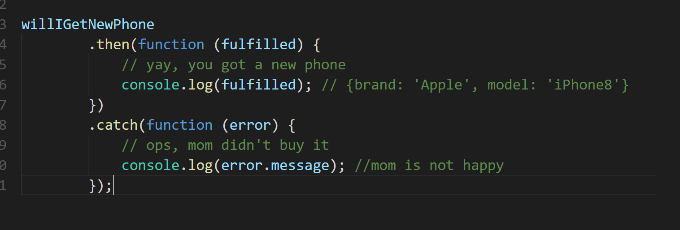

Slide 10
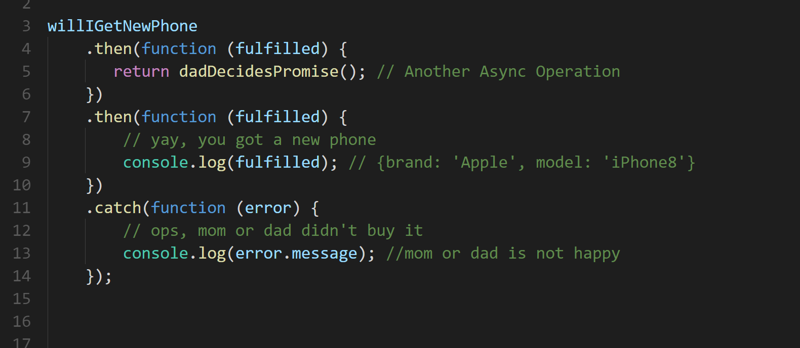

Slide 11
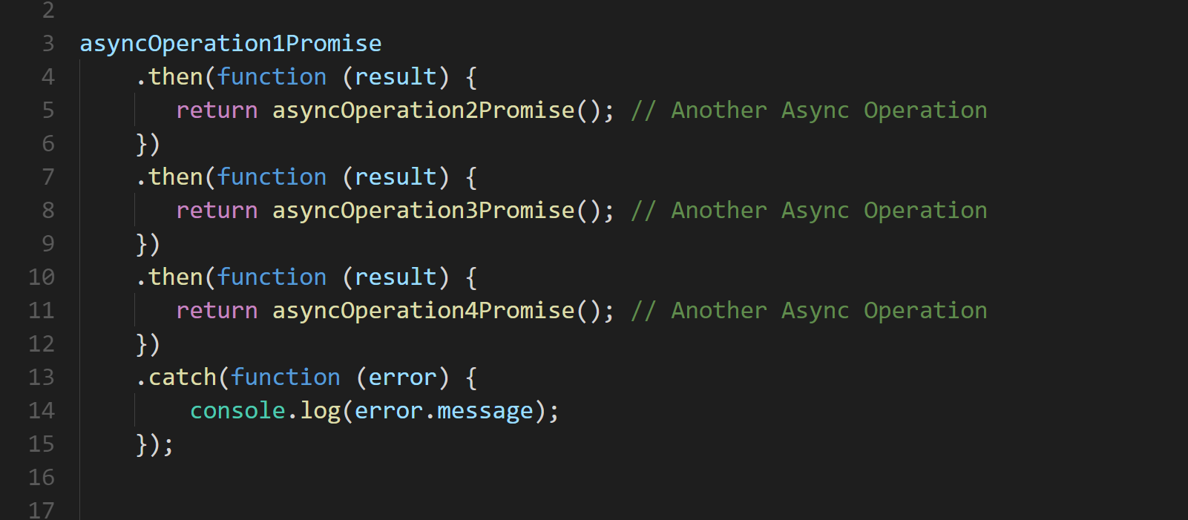
Notes:
Promises help us to better handle async

Slide 12


Notes:
Promises help us to better handle async

Slide 13
Angular and RxJS Why we want to break Promises
Rogeross Beraña
RFI Software Engineer
CACIB TECHTALK

Slide 14

Angular
a JavaScript framework that helps developers build applications
https://angular.io/
Notes:
Left to right
Top to bottom
Block of code

Slide 15

Reactive Extensions for Javascript
library for composing asynchronous and event-based programs
http://reactivex.io/
Notes:
Left to right
Top to bottom
Block of code

Slide 16
Reactive Extensions for Javascript
relies on observable sequences
http://reactivex.io/
Notes:
Left to right
Top to bottom
Block of code

Slide 17
Reactive Extensions for Javascript
used with Angular
http://reactivex.io/
Notes:
Left to right
Top to bottom
Block of code

Slide 18
PROMISE
An operation that hasn’t completed yet, but is expected in the future
Used with async/deferred operations
Can be hooked to a callback
PROMISES
and
OBSERVABLES
Notes:
Left to right
Top to bottom
Block of code

Slide 19
OBSERVABLES
An object that can be subscribed to by other objects
Can return multiple values over time – an async data stream
Event based
PROMISES
and
OBSERVABLES
Notes:
Left to right
Top to bottom
Block of code

Slide 20
PROMISES OVERVIEW
CALL
I’M A DATA
Angular Service
PROMISE
Angular Component

Slide 21
OBSERVABLES OVERVIEW
I’M A DATA
SUBSCRIBE
OBSERVABLE
SUBSCRIBER
Angular Service
Angular Component

Slide 22
OBSERVABLES OVERVIEW
DATA
DATA
DATA
SUBSCRIBE
OBSERVABLE
SUBSCRIBER
Angular Service
Angular Component

Slide 23
PROMISES and OBSERVABLES overview
PROMISES
Returns a single value
Cannot cancel
Natively supported in browsers
OBSERVABLES
Can return multiple values overtime
Can cancel
Support standard array functions (map, filter, reduce, etc.)
Relies on library such as RxJS
Notes:
Left to right
Top to bottom
Block of code

Slide 24
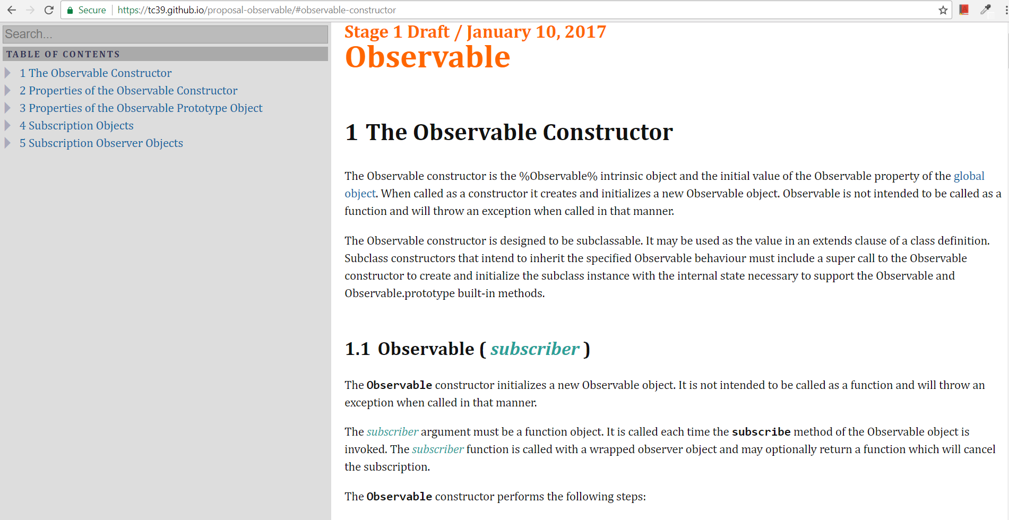
Observable Stage 1 Draft
https://tc39.github.io/proposal-observable

Slide 25
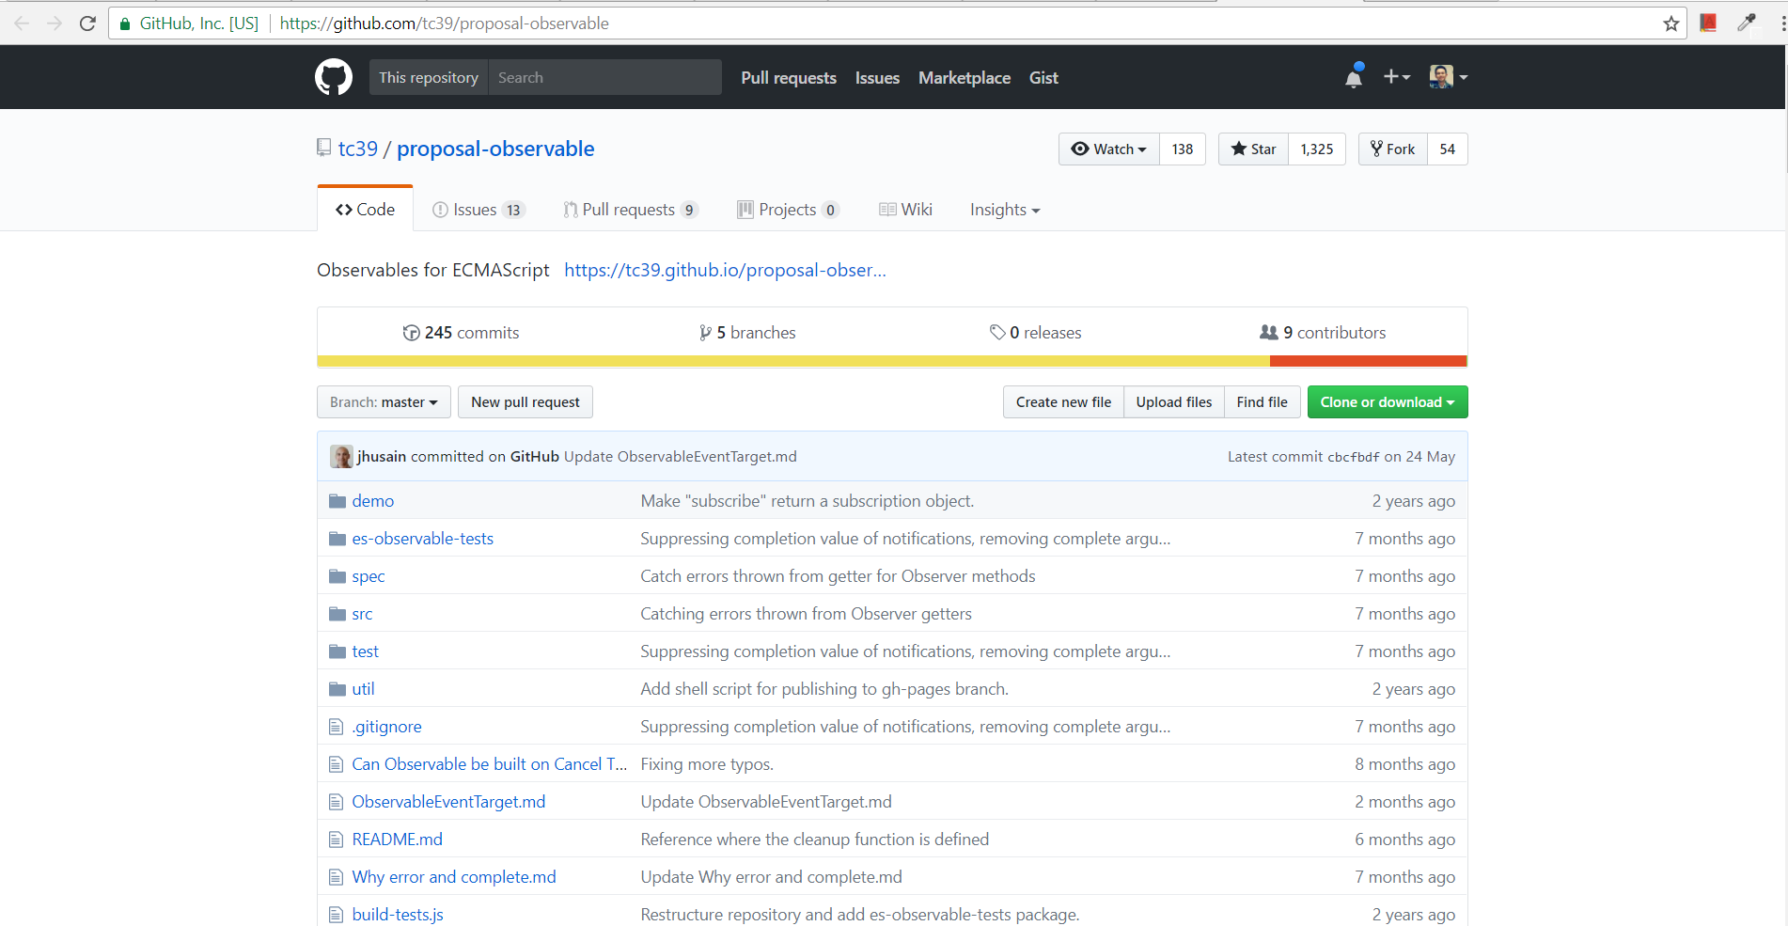
Observable Github Repo
https://github.com/tc39/proposal-observable

